Slide 1
Exercise, Thermoregulation, Fluid Balance, and Rehydration

Slide 2
Objectives
Describe mechanisms of thermoregulation in the body
Define hyponatremia, dehydration, rehydration, and acclimatization
List factors that improve heat tolerance
Define and describe the symptoms of heat cramps, heat exhaustion, and heat stroke

Slide 3
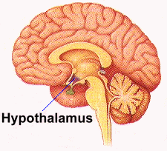
Thermoregulation and the Hypothalamus
Thermoregulation
The process that allows the human body to maintain its core internal temperature
Regulated by the hypothalamus. Works to protect the body from heat gain or heat loss
Internal thermostat

Slide 4
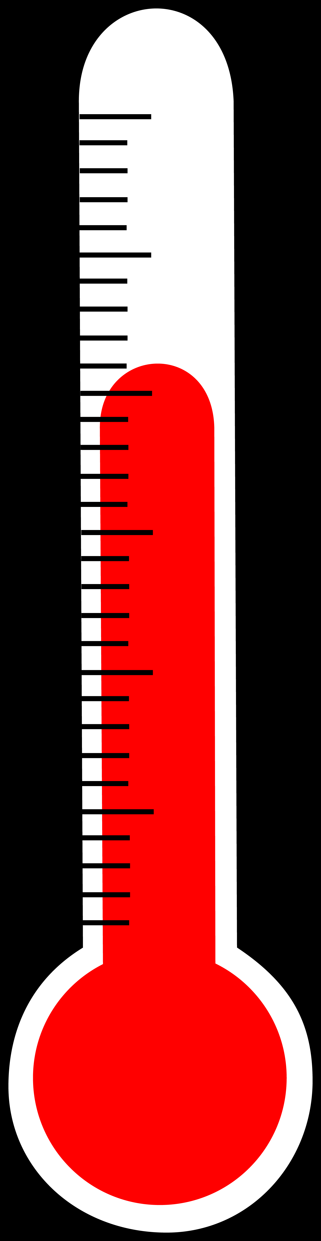
Body Temperature
Hyperthermia is an increase in body temperature by 5C or more
Core body temperature: deep tissues
Shell body temperature: peripheral
Core temperature rises quickly when heat gain exceeds heat loss
Notes:
The relative stress of exercise determines the magnitude of the temperature increase. Core temperature rises quickly during vigorous exercise in a warm environment

Slide 5
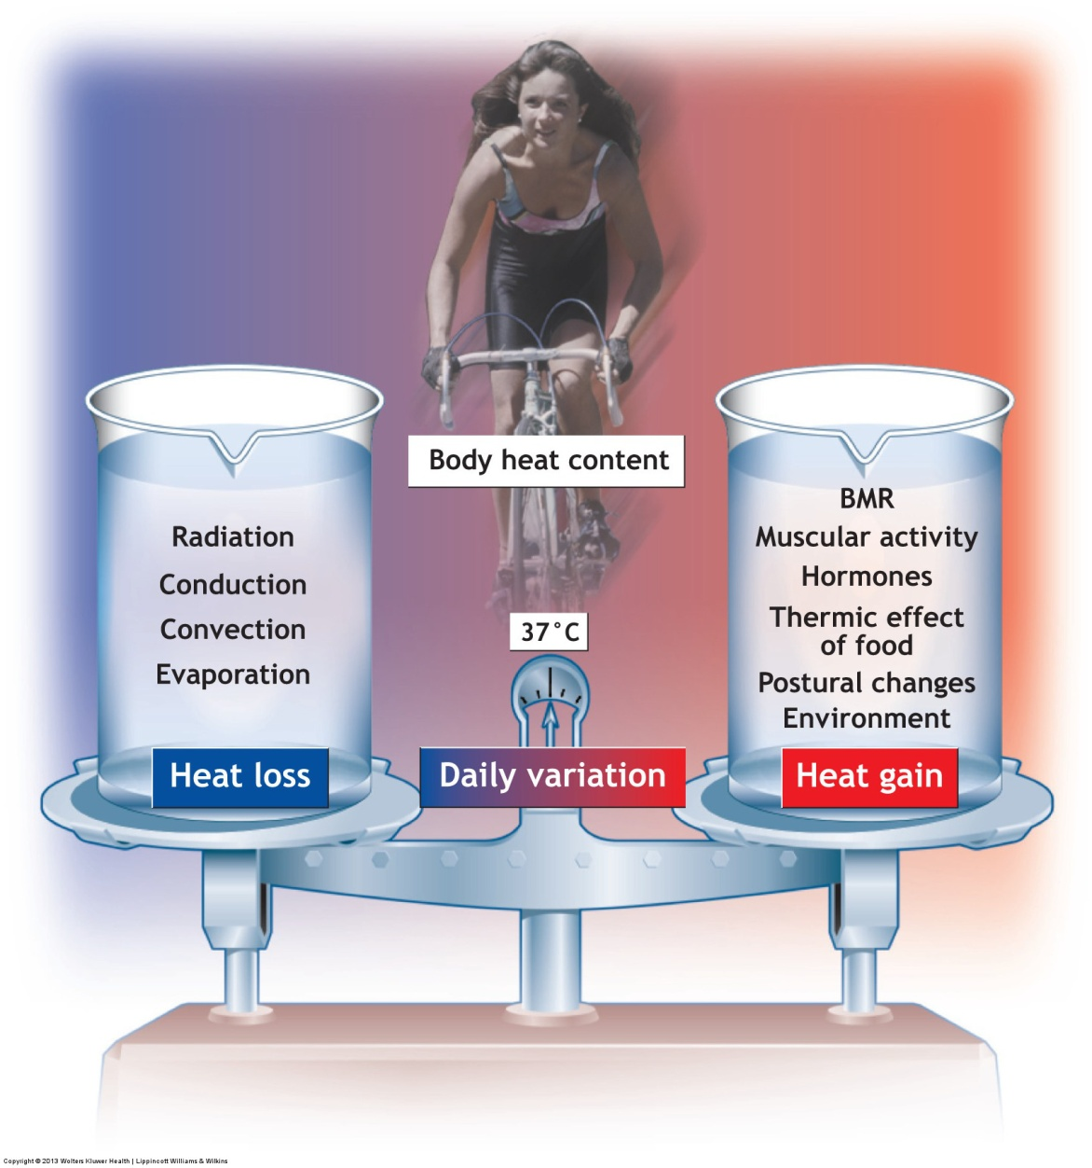
Notes:
Factors that contribute to heat gain and heat loss to regulate core temperature at about 37˚C

Slide 6
Heat-Regulating Mechanisms
Become activated in 2 ways:
Temperature changes in blood around the hypothalamus directly stimulate this thermoregulatory control center
Thermal receptors in the skin provide input to regulate hypothalamic activity
Structures in the skin tissue help to regulate temperature

Slide 7
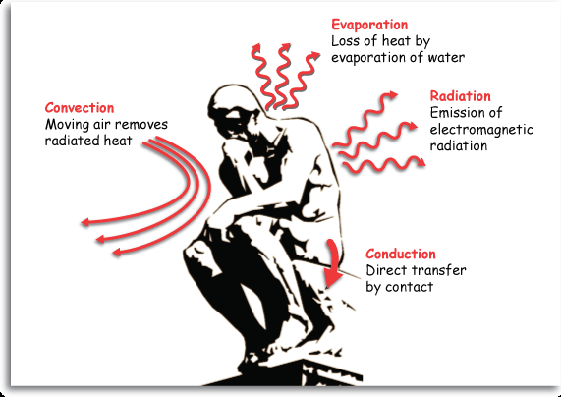
Thermoregulation during Heat Loss
Radiation
Conduction
Convection
Evaporation
Notes:
The body’s thermoregulatory mechanisms primarily protect against overheating.

Slide 8
Radiation
Objects emit electromagnetic heat waves
Body temperature is warmer than the environment
Radiant heat energy leaves the body through air to solid cooler objects around us
Notes:
This form of heat transfer, similar to how the sun’s rays warm the earth, does not require molecular contact between objects.

Slide 9
Conduction
Transfers heat directly through a liquid, solid, or gas from one molecule to another
The circulation transports most of the body heat to the shell
A small amount continually moves by conduction directly through the deep tissues to the cooler surface
Notes:
The rate of conductive heat loss depends on the temperature gradient between the skin and surrounding surfaces and their thermal qualities.

Slide 10
Convection
Air movement
Warm air next to the skin acts as a zone of insulation
If cool air continuously replaces the warmer air surrounding the body, heat loss increases
Notes:
For example, air currents at 4 miles per hour cool twice as effectively as air moving at 1 mile per hour.

Slide 11
Evaporation
Major physiologic defense against overheating
Water vaporization from the respiratory passages and skin surface continually transfers heat to the environment
Cooling occurs when sweat evaporates from the skin surface
Notes:
Along with heat loss through sweating, approximately 350 mL of water seeps through the skin (called insensible perspiration) each day and evaporates to the environment. Also, approximately 300 mL of water vaporizes daily from the respiratory passages’ moist mucous membranes.

Slide 12
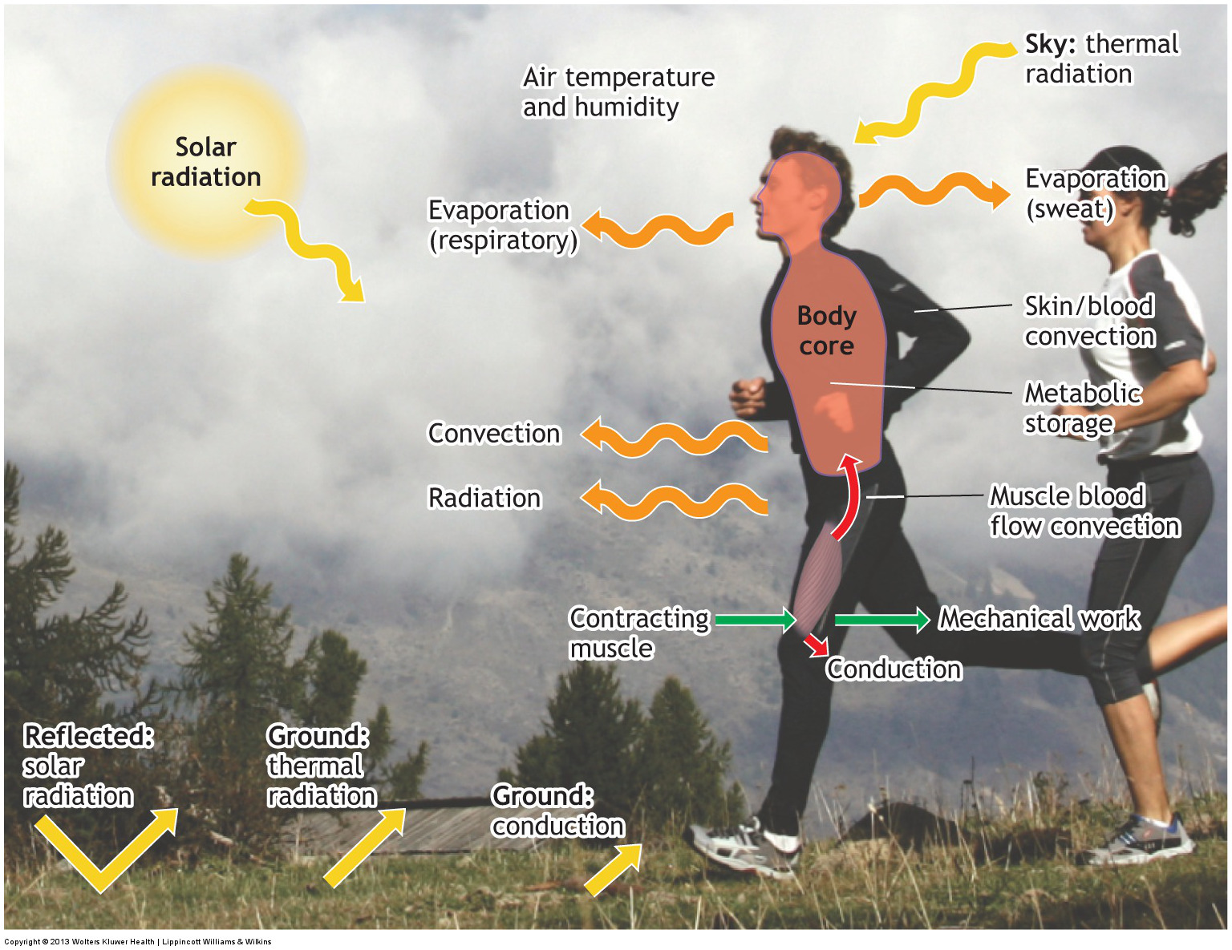
Notes:
Heat production within active muscle and its subsequent transfer from the core to the skin. Under appropriate environmental conditions, excess body heat dissipates to the environment and core temperature stabilizes within a narrow range.

Slide 13
Environmental Temperature
Increased ambient temperature reduces the effectiveness of heat loss by conduction, convection, and radiation
Sweat evaporation from the skin depends on:
Surface exposed to the environment
Temperature and relative humidity of ambient air
Convective air currents around the body
Notes:
For someone relaxing in a hot, humid environment, the normal 2-L daily fluid requirement doubles or even triples from evaporative fluid loss.
Relative humidity exerts the greatest impact on the effectiveness of evaporative heat loss.
Relative humidity refers to the percentage of water in ambient air at a particular temperature compared with the total quantity of moisture that the air could carry.

Slide 14
Heat-Dissipating Mechanisms
Circulation
workhorse to maintain thermal balance
Evaporation
Hormones
antidiuretic hormone (ADH)
Aldosterone
Notes:
At rest in hot weather, heart rate and blood flow from the heart (cardiac output) increase while superficial arterial and venous blood vessels dilate to divert warm blood to the body’s shell.
A large cutaneous blood flow coupled with evaporative cooling generally produces an effective thermal defense.
ADH increases water reabsorption from the kidney tubules, causing urine to become more concentrated.
Aldosterone increases the renal tubules’ reabsorption of sodium and decreases sodium concentration in sweat, which aids in additional electrolyte conservation.

Slide 15
Evaluating Environmental Heat Stress
Factors impacting physical strain from heat
Body size and fatness
Level of training
Acclimatization
Adequacy of hydration
External factors

Slide 16
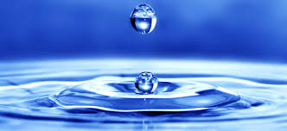
Water Loss
Dehydration
Consideration water loss occurs during several hours of intense exercise in a hot environment
Both intracellular and extracellular compartments contribute to fluid deficit
The risk of heat illness greatly increases when a person begins exercising in a dehydrated state
Notes:
Dehydration refers to an imbalance in fluid dynamics when fluid intake does not replenish water loss from either hyperhydrated or normally hydrated states.

Slide 17
Dehydration and Exercise
Dehydration impairs the capacity of circulatory and temperature-regulating mechanisms to adjust to exercise demands
Dehydrations, as little as 2% of body mass, impairs physical work capacity and physiologic function
The risk for dehydration increases during vigorous cold weather exercise
Notes:
Colder air contains less moisture than air at warmer temperature, particularly at higher altitudes. Greater fluid volumes leave the respiratory passages as the incoming cold, dry air becomes fully humidified and warmed to body temperature. Cold stress also increases urine production, which adds to total-body fluid loss.

Slide 18
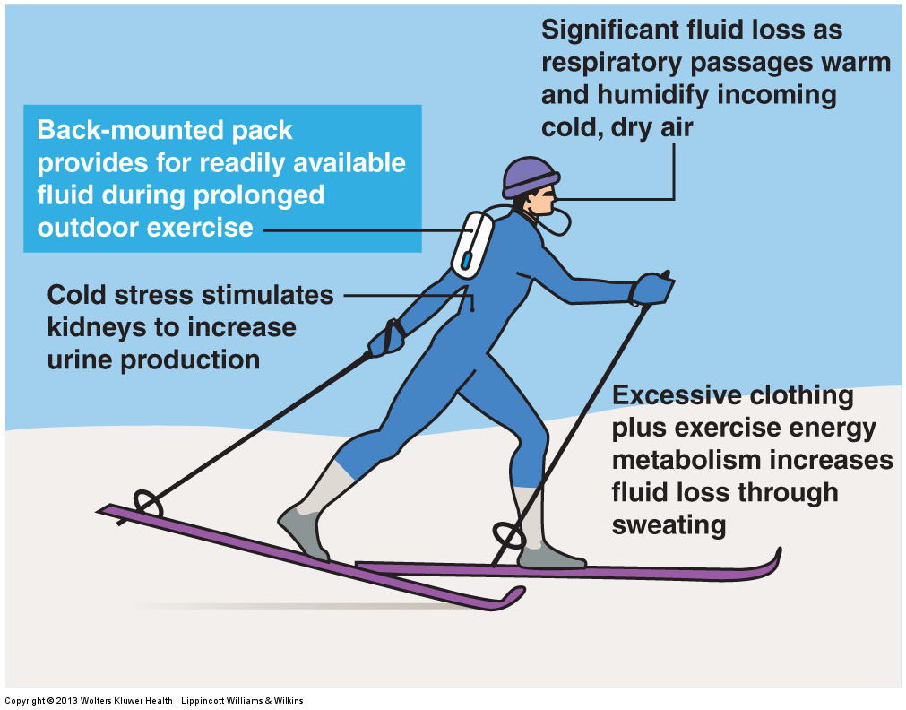
Notes:
Factors that increase the potential for dehydration during cold-weather exercise. The illustration depicts a back-mounted hydration system to provide ready access to water during continuous exercise in the outdoor environment.

Slide 19
Rehydration
Properly scheduling fluid replacement maintains plasma volume
Achieving hyper-hydration before exercising in a hot environment protects against heat stress because it:
Delays dehydration
Increases sweating during exercise
Diminishes the rise in core temperature
Notes:
In addition to increasing fluid intake 24 hours before strenuous exercise in the heat, it is recommend to consume 400 to 600 mL (13-20 oz) of cool water about 20 minutes before exercise.
Pre-exercise hyperhydration does not replace the need to continually replace fluid during exercise.

Slide 20
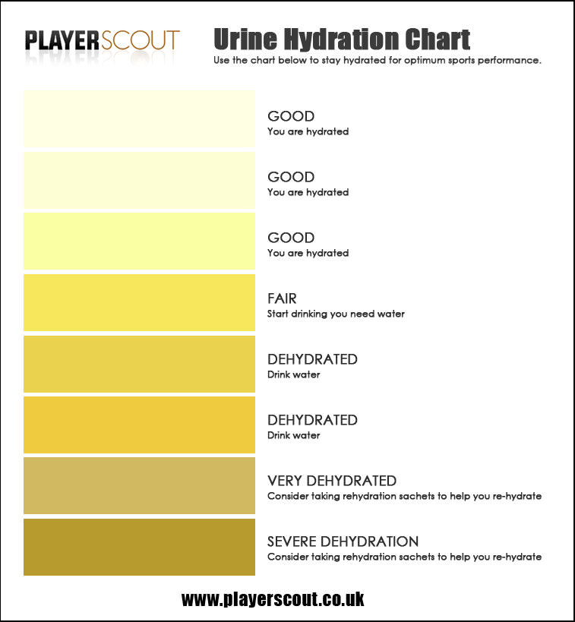
Adequacy of Rehydration
Body weight changes indicate the extent of water loss
Urine and hydration:
Dark yellow urine with a strong odor = inadequate hydration
Large volume, light color, without a strong odor = adequate dydration
Notes:
Drink at least 125-150% of the existing fluid loss (body weight loss) as soon as possible after exercising. The 25-50% “extra” water accounts for that portion of ingested water lost in urine.

Slide 21
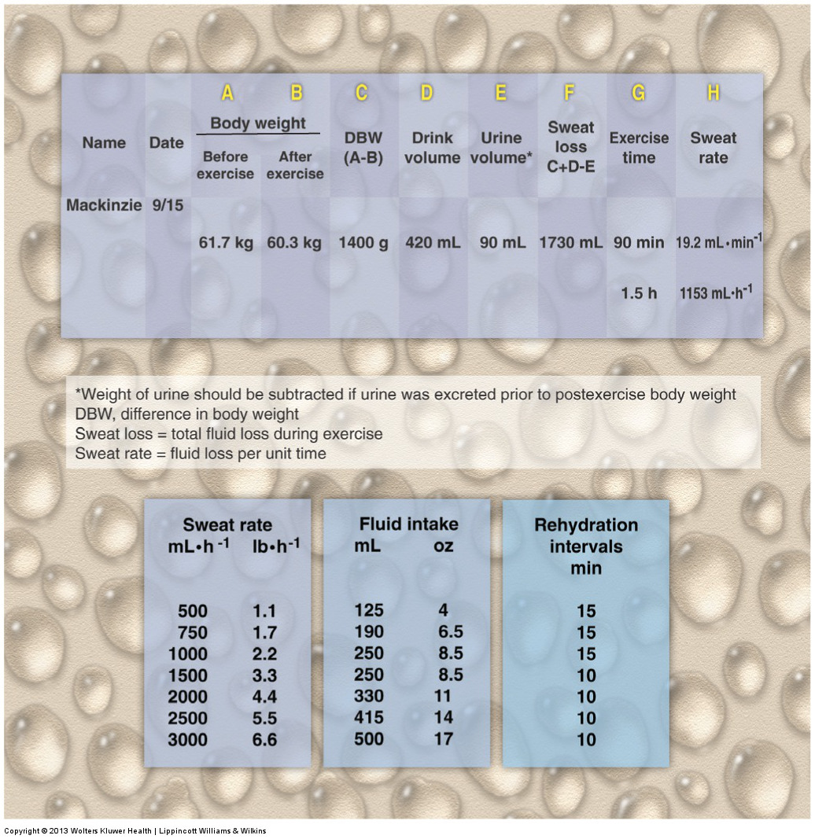
Notes:
Computing the magnitude of sweat loss and rate of sweating in exercise. In this example, Mackinzie should drink about 1000 mL of fluid during each hour of activity to remain well hydrated (250 mL every 15 minutes).

Slide 22
Sodium and Rehydration
A moderate amount of sodium added to a rehydration beverage provides more complete rehydration
Maintaining a relatively high plasma concentration of sodium helps:
Sustain the thirst drive
Promote retention of ingested fluids
More rapidly restore lost plasma volume during rehydration
Notes:
Restoring water and electrolyte balance in recovery occurs most effectively by adding moderate to high amounts of sodium (100 mmol·L⁻¹, an amount exceeding that in commercial beverages) to the rehydration drink or combining solid food (with appropriate sodium content) with plain water.

Slide 23
Hyponatremia
Low blood level of sodium (<135mEq/L)
Can occur due to excessive water intake
A sustained low plasma sodium concentration creates an osmotic imbalance
The resulting swelling of brain tissue produces a cascade of symptoms that range from mild to severe
Notes:
Mild: headache, confusion malaise, nausea, cramping
Severe: seizures, coma, pulmonary edema, cardiac arrest, death

Slide 24
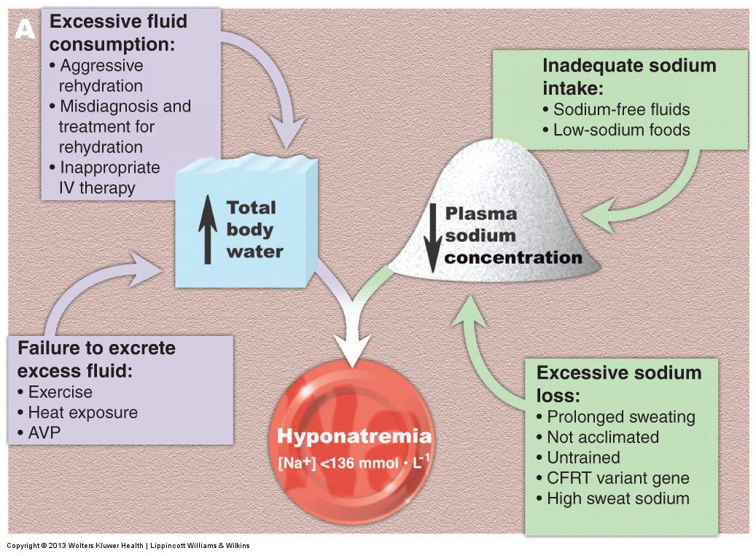
Notes:
Factors that contribute to the development of hyponatremia.

Slide 25
Acclimatization
Definition: The physiologic adaptations that improve heat tolerance
The acclimatized individual:
Has larger quantities of blood shunt to cutaneous vessels
Has more effective cardiac output
Has an earlier onset of sweating
Notes:
After 10 days of heat exposure, sweating capacity nearly doubles, and sweat becomes dilute (less salt lost) and more evenly distributed on the skin surface. Optimal acclimatization necessitates adequate hydration.

Slide 26
Age Differences in Acclimatization
Older individuals have:
a lower sensitivity of thermoreceptors
limited sweat gland output
Dehydration-limited sweat output with insufficient fluid replacement
Altered structure and function of the skin
A decreased recovery from dehydration

Slide 27
Heat Illnesses
Heat cramps
involuntary muscle spasms that occur after intense physical activity
Heat exhaustion
most common heat illness
Heat stroke
most serious and requires immediate medical attention
Notes:
If left untreated, the disability becomes fatal from circulatory collapse, oxidative damage, a systemic inflammatory response, and damage to the central nervous system and other organs.
Immediate treatment includes alcohol rubs and application of ice packs. Whole-body cold or ice water immersion remains the most effective treatment for a collapsed hyperthermic individual.

Slide 28
Characteristics of Heat Illnesses
Heat Cramps | Heat Exhaustion | Heat Stroke
Involuntary jerk or spasm of muscle | Confustion | Most sever from of heat illness
Can occur during exercise or a few hours later | Dark colored urine (dehydration) | High body temperature >= 104 f or higher
Muscles are fatigued by heavy work calves, thighs, shoulders | Dizziness | Altered mental stat or behavior
 | Fainting | Flushed skin
 | Fatigue | Rapid breathing
 | Nausea , Vomiting | Headache

Slide 29
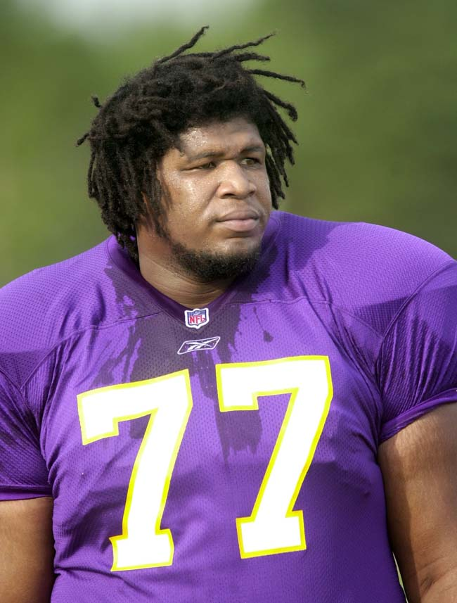
Korey Stringer Dies of Heat Stroke on August 1, 2001
Died at age 27
Collapsed during football camp(internal body temperature registered over 108 degrees)
Medical experts say death was preventable
Read Korey’s full story: http://ksi.uconn.edu/about/koreys-story/

